Slide 1
History of Radio

Slide 2
The Roots of Radio
During the 1860s, Scottish physicist, James Clerk Maxwell predicted the existence of radio waves.
In 1886, German physicist, Heinrich Rudolph Hertz demonstrated that rapid variations of electric current could be projected into space in the form of radio waves similar to those of light and heat.
In 1866, Mahlon Loomis, an American dentist, successfully demonstrated "wireless telegraphy." Loomis was able to make a meter connected to one kite cause another one to move, marking the first known instance of wireless aerial communication.

Slide 3
Guglielmo Marconi
Guglielmo Marconi, an Italian inventor, proved the feasibility of radio communication.
He sent and received his first radio signal in Italy in 1895.
By 1899 he flashed the first wireless signal across the English Channel and two years later received the letter "S", telegraphed from England to Newfoundland.
This was the first successful transatlantic radiotelegraph message in 1902.

Slide 4
Nikola Tesla
In addition to Marconi, two of his contemporaries Nikola Tesla and Nathan Stufflefield took out patents for wireless radio transmitters.
Nikola Tesla is now credited with being the first person to patent radio technology; the Supreme Court overturned Marconi's patent in 1943 in favor of Tesla.

Slide 5
Improvements to Radio Transmitters
Overseas radiotelegraph service developed slowly, primarily because the initial radiotelegraph transmitter discharged electricity within the circuit and between the electrodes was unstable causing a high amount of interference.
The Alexanderson high-frequency alternator and the De Forest tube resolved many of these early technical problems.

Slide 6
Lee DeForest - AM Radio
Lee De Forest provided it possible to amplify the radio frequency signal picked up by the antenna before application to the receiver detector; thus, much weaker signals could be utilized than had previously been possible. De Forest was also the person who first used the word "radio".
The result of Lee DeForest's work was the invention of amplitude-modulated or AM radio that allowed for a multitude of radio stations. The earlier spark-gap transmitters did not allow for this.

Slide 7
True Broadcasting Begins
In 1915, speech was first transmitted across the continent from New York City to San Francisco and across the Atlantic Ocean from Naval radio station NAA at Arlington, Virginia, to the Eiffel Tower in Paris.
On November 2, 1920, Westinghouse's KDKA-Pittsburgh broadcast the Harding-Cox election returns and began a daily schedule of radio programs.

Slide 8
Radio Broadcast in sub-continent
March 1926 Indian Broadcasting Company, a private company was formed in Bombay.
23rd July 1927 IBC launched its transmission.
1928 A small transmitting station was set up at Lahore.
April 1930 Broadcasting went under the direct control of Government and IBC was changed to Indian State Broadcasting Service.
Jan. 1934 The Indian Wireless Telegraphy Act 1933 came into force.
Jan. 1935 Peshawar Radio Station was set up by NWFP Government – 250 watts transmitter.
Jan. 1936 Delhi Radio Station was opened. A.S. Bukhari was appointed as its 1st Station Director.
Jun 1936 Indian State Broadcasting Service was changed into All India Radio.
Dec 1937 Lahore station went on air.
1939 Dhaka Radio station was opened.

Slide 9
Radio Broadcast in Pakistan
Aug 14, 1947 Pakistan comes into being and the announcement of its creation is made by the new organization, the Pakistan Broadcasting Service which comes into existence at the same time and later designated as Radio Pakistan.
When Pakistan came into being it had three radio stations: Lahore, Peshawar and Dhaka. Setting up of further radio stations in every nook and corner of Pakistan is as under:
1948 Rawalpindi-3 Radio Station. – 500 watts’ shortwave transmitter
1948 Karachi Radio station – 100 watts’ shortwave transmitter
1949 Rawalpindi station – 100 watts’ Medium wave transmitter
1950 Karachi Radio Station
1939 Dhaka Radio station was opened.

Slide 10
Radio Broadcast in Pakistan
1951 Hyderabad Radio Station – 1 KW/ SW transmitter
Oct 1956 Quetta Radio Station 1 KW/ SW Transmitter
Oct 1960 Rawalpindi – 2 Radio Station 1KW/ SW Transmitter
1970 Staff training and technical training school at Islamabad.
1970 Multan Radio Station 120 KW/ MW.
20 Dec.1972 Radio Pakistan was converted into “Pakistan Broadcasting Corporation. (PBC)
April 1973 World service for overseas Pakistanis
1974 Khairpur Radio station 100 KW
August 1975 Bhawalpur Radio Station 10 KW/ MW

Slide 11
Radio Broadcast in Pakistan
1977 Islamabad Radio Station in the new national Broadcasting house 1000 KW/ MW transmitter
1977: Skardu Radio Station 250 W/MW
1981: Turbat Radio Station 250 W/MW
1981: D.I. Khan Radio Station 10 KW/MW
1981: Khuzdar Radio Station 250 W/MW
Sept 1982: Faislabad Radio Station 250 W/MW
May 1986: New BH at Khairpur
1989: Sibi Relay Station - 250 W Trans
1989: Abbotabad Relay Station 250 W/Trans
Aug 1993: Chittral Radio Station 1 KW/FM Trans
1996: Loralai Radio Station 10 KW/MW
1996: Zhob Radio Station 10 KW/MW

Slide 12
History of television

Slide 13
History of television
Invention of TV was a collective work of different people
Inventors from all over the world had been working on transmitting pictures or objects onto a screen since the 1830’s, but the first physical television didn’t evolve until the 1900’s
German inventor named Paul Nipkow invented the first rotating disk that would allow pictures to transmit over wire in 1884
This discovery was the first electromechanical television scanning system in the world.

Slide 14
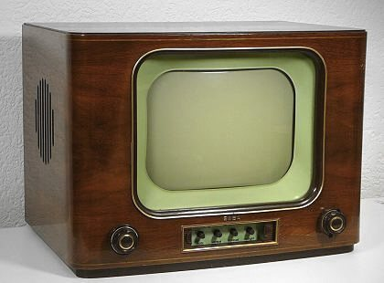
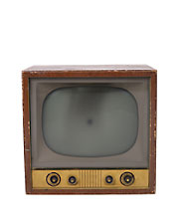
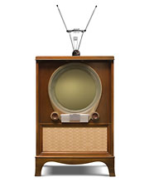
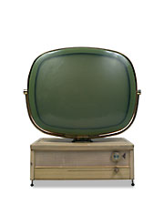
Early Television set Pictures

Slide 15
History of television
The earliest proposal was in 1908, in a paper by A. A. Campbell-Swinton and postulated the use of cathode rays.
The first practical demonstrations of television, though, were developed using electromechanical methods to scan, transmit, and reproduce an image.
As electronic camera and display tubes were perfected, electromechanical television gave way to all-electronic systems in nearly all applications.

Slide 16
Vladimir Zworykin
Vladimir Zworykin invented the Cathode Ray tube, which he named the Kinescope and started a new era in the history of TV.
Before the Kinescope, televisions in the 1920’s were mechanical. The Cathode Ray tube was not only needed for transmission; this device transformed the television into an electronic device.

Slide 17
Charles Jenkins
Charles Jenkins invented a mechanical television that he called “radio vision,” which was said to have transmitted one of the first moving images in 1923
This American inventor went on to promote his theories in the technology of the television along with other inventors when they transmitted the first live pictures onto a screen
This pilgrim in the history of the television is also famous for creating the first television station in North America.

Slide 18
John Baird
John Baird became famous when he invented the first pictures in motion that were televised in Europe in 1924
He later transmitted the human face onto a screen, and during World War II invented the first color picture tube
While it would be some time before color TV became a staple in American households, his contribution to the history of TV was enormous.

Slide 19
Philo Farnsworth
Finally, an American farmer named Philo Farnsworth made a breakthrough in the history of TV at the age of 13, when he discovered a way to transmit images onto a screen by the use of 60 horizontal lines,
It made picture clear
Farnsworth also invented over 165 devices, including the dissector tube, which became the groundwork for televisions we use today.

Slide 20
Early Television
On early TV’s, you could only watch a play on a screen the size of a dollar coin
The actors also had to take turns in front of the camera, because the screen was only big enough to see one person at a time.
In 1931 Allen B. Du Mont made the first commercially practical and durable CRT for television
The CRT technology allowed TV screens to get bigger and better. But all televisions during these early years were black and white
It wasn't until 1953 that the introduction of the first color TV broadcasts occurred and manufacturers raced to make color TVs for eager consumers.
Most people did not get a color TV until the mid 60's.

Slide 21
First Commercial Televisions
People feared the new technology, thinking that televisions could transmit personal conversations onto the TV
The 1928 Baird model mechanical television sets were introduced to the public at the “Olympia” Radio Exhibition in 1929
These mechanical TV sets projected orange-red blurry images on a screen about the size of a dollar coin.
The first televisions sold for about fifty-five dollars, which only people of wealth could afford

Slide 22
Television in the United Kingdom
Public television broadcasting started in the United Kingdom in 1936
collection of free and subscription services with 480 channels
The UK's five most watched channels
BBC One
BBC Two
ITV
Channel 4
Channel 5

Slide 23
Television in the United States
Decentralized, market-oriented television system
No national broadcast programming service
five major U.S. networks are NBC, CBS, ABC, Fox, and The CW
Independent Channels
The Oprah Winfrey Show
reality television

Slide 24
Modern Television
A television set, also called a television, TV set, TV, or "Telly" (UK) is a device that combines a tuner, display, and speakers for the purpose of viewing television.
Television sets became a popular consumer product after the Second World War, using vacuum tubes and cathode ray tube displays.

Slide 25
Modern Television
After 1953, television became more popular and common among the masses.
People started keeping TV set in their houses as the an outdoor antenna became most common feature of suburban homes.
The shape of the television also changed in the modern era, it became more slim and light in weight.

Slide 26
Modern Television
Modern television sets incorporate liquid-crystal flat-screen displays, solid-state circuits and microprocessor controls.
They can interface with a variety of video signal sources, allowing the user to view broadcast and subscription cable TV signals or satellite television.
They can also display recorded material on DVD disks or VHS tape, or less common devices such as home security systems, and even over-the-air broadcasts received through an indoor or outdoor antenna.

Slide 27
Modern Television
The screen of the television converted to LCD (liquid crystal display) and now emerging technology is LED, which consume less electricity and it efficiency is more.
Also emerging televisions are now smart TVs, which can process things and also gives you variety of things to do at the same time, having processor and board, such as synchronizing, video calling, retina display, touch display screen LCD and auto features, especial OS – operating system is installed in it.

Slide 28
World Program History
Sept. 11, 1928. First play broadcast by television, "The Queen's Messenger," on W2XAD. The event was reported on page 1 of the New York Times the next day.
The show ran for about 80 minutes and the sound was carried on the General Electric's radio station.
1929. Milton Berle appears in an experimental TV broadcast. Film of the appearance survives.
May 11, 1929. The "first regularly scheduled TV broadcasts" begin (one source), three nights per week.

Slide 29
World Program History
July 21, 1931. W2XAB New York (CBS) begins broadcasting the first regular seven-day-per-week TV broadcasting schedule in the U. S., 28 hours per week with live pickups and a wide variety of programs.
The first broadcast included Mayor James J. Walker, Kate Smith, and George Gershwin.
May 31, 1938. W2XBS telecasts the movie The Return of the Scarlet Pimpernel, starring Leslie Howard; the staff projectionist played the last reel out of order, ending the film 20 minutes early.
After this incident, NBC could not obtain first-run movies for many years.

Slide 30
World Program History
April 30, 1939. President Roosevelt is the first President to appear on television, from the New York World's Fair on W2XBS, now transmitting on 45.25 MHz visual and 49.75 MHz aural.
June 1, 1939. First heavyweight boxing match televised, Max Baer vs. Lou Nova, form Yankee Stadium

Slide 31
History of TV in Pakistan
On 26 November 1962, after an introduction by Wajid Ali, the first news were broadcast which beamed black and white transmission by the PTV.
Initially, transmission was live and as it is because no proper mechanism was there for recording and for display recorded programs.
Mostly, dramas and shows were performed live and telecasted, was no margin for mistake in the live programs.
All the transmissions were black and white, initially.

Slide 32
History of TV in Pakistan
The first program, formatted by Thomas Television International, telecast amateur programs with foreign films;
the television division in the Punjab Province was established with the help of United Nations Educational, Scientific and Cultural Organization (UNESCO), the Colombo Plan, and the Government of Japan.

Slide 33
History of TV in Pakistan
The PTV remained under the private sector management but more than half of the shares were sold to Ministry of Information and Broadcasting in a fear that all shares would fall into the hands of government in the name of greater interest of the country.
President Ayub Khan appointed Ubaid ur Rahman in the Ministry of Information to continue with the NEC joint venture collaboration in launching the PTV.
The project began with a tent on the back lot of Pakistan Broadcasting Corporation by Ubaid ur Rahman where a transmission tower and a studio were constructed by his team.

Slide 34
History of TV in Pakistan
On 26 November 1964, President Ayub Khan inaugurated the first official television station commencing transmission broadcasts from Lahore.
Then it was followed by Dhaka, Bangladesh in 1965 (then the capital of East Pakistan, a third centre was established in Rawalpindi and Islamabad in 1965 and the fourth in Karachi in 1966.
On 29 May 1967, the private company established as "Pakistan Television Corporation" under the Company Act, 1913, with private sector remains charged with broadcasting the television.

Slide 35
Historical Programs in Pakistani TV History
During the decades of the 1970s, 1980s and 1990s, PTV dramas and teleplays were considered as the best in the Indian subcontinent.
These included Khuda Ki Basti, Unkahi, Tanhaiyaan, Aangan Terha, Fifty Fifty, Studio Dhai (2-1/2), Studio Ponay Teen (2-3/4), Andehra Ujala, Sona Chandi

Slide 36
Historical Programs in Pakistani TV History
Uncle Urfi, Taleem-e-Baalighan, Alif Noon, Waaris, Dhoop Kinare, Sunehray Din, Alpha Bravo Charlie, Ana, Akhri Chatan, Zair Zabar and block buster serials like Pesh, Dhuwan, Kath Putli, Wafa Ham Nibhaein Gai, Bandhan, Kaghaz Kay Phool, Muqqdas, Bint-e-Adam, Malangi, Sawan, Sheela Bagh, Tinkay,

Slide 37
Historical Programs in Pakistani TV History
Aisa Bhi Hota Hai bhar, rasta de zindgi, Chuban, Kuch Lamhay, khuwahesho kay sarab, and many others
A few of the programs were very popular even in India. Indian streets becomes deserted when few of the most popular TV dramas were broadcast. Although Pakistan and India are the arch rivals, still the dramas of PTV were very popular in India.

Slide 38
Early TV Stations in Pakistan
PTV 1 Changed its name to PTV Home
PTV 2 Shut Down
PTV World Changed its name to PTV World News
PTV World News Changed its name to PTV News
Channel 3 Shut Down
Prime Entertainment Shut Down
Sunday TV Shut Down
OYE TV Shut Down
Uni Plus Shut Down
Musix Station Shut Down
Fun TV Shut Down
The Musik Replaced with ARY Musik
Rung TV Shut Down

Slide 39
Early TV Stations in Pakistan
Pak TV Shut Down
Mashriq TV Shut Down
FORTUNE TV Shut Down
KOOK TV - Replaced with 8XM Jalwa
NTM Shut Down
PTN Shut Down
STN Shut Down
UTN Shut Down
Shamal TVShamal TV Network, First Hindko Channel

Slide 40
Private TV channels in Pakistan
The free electronic media in Pakistan was initiated by military dictator General Musharraf.
In March 2002, he decided to set up Pakistan Electronic Media Regulator Authority (PEMRA) with a view to facilitate, license and regulate the growth of electronic media in the private sector.

Slide 41
Private TV channels in Pakistan
Satellite and cable channels are fast emerging on the Pakistani media scene. The trend started in the years 2000-2001. Indus TV Network was the first independent satellite channel.
Indus Media Group (IMG) owns and operates INDUS TV NETWORK (PRIVATE) LIMITED and the INDUS brand of television channels in various global markets.
IMG entered the Pakistani market in 2000 with the launch of its flagship channel INDUS VISION – the first independent satellite channel and a drama channel.

Slide 42
Private TV channels in Pakistan
ARY NEWS
ARY Group of companies, owned by a Dubai-based Pakistani businessman, launched ARY Digital from the United Kingdom in December 2000, to cater to the rising demand of family entertainment for the viewers of South Asian origin living in Europe.
The channel began its transmission in Pakistan and other parts of Asia from September 2001.
Located in Dubai Media City since May 2003 ARY Digital has added to its network a music channel, The Musik, a 24-hour news and current affairs channel, ARY One World.
ARY One World until 2009 when it was re-branded as ARY News

Slide 43
Private TV channels in Pakistan
GEO
Karachi-based Pakistani news channel
fully owned and operated by Jang Group
started its broadcasting in 2002

Slide 44
Private TV channels in Pakistan
HUM TV
24-hour Pakistani entertainment TV channel based in Karachi
first brand of Eye Television Network Limited, Pakistan
Launched on January 17, 2005
Masala TV was launched on 22 November 2006 in Pakistan

Slide 45
History of FIlm

Slide 46
History of Film
1827 First still photograph taken,
Claude Niepce's photograph
The View from a Window at Le Gras took nearly eight hours to expose.

Slide 47
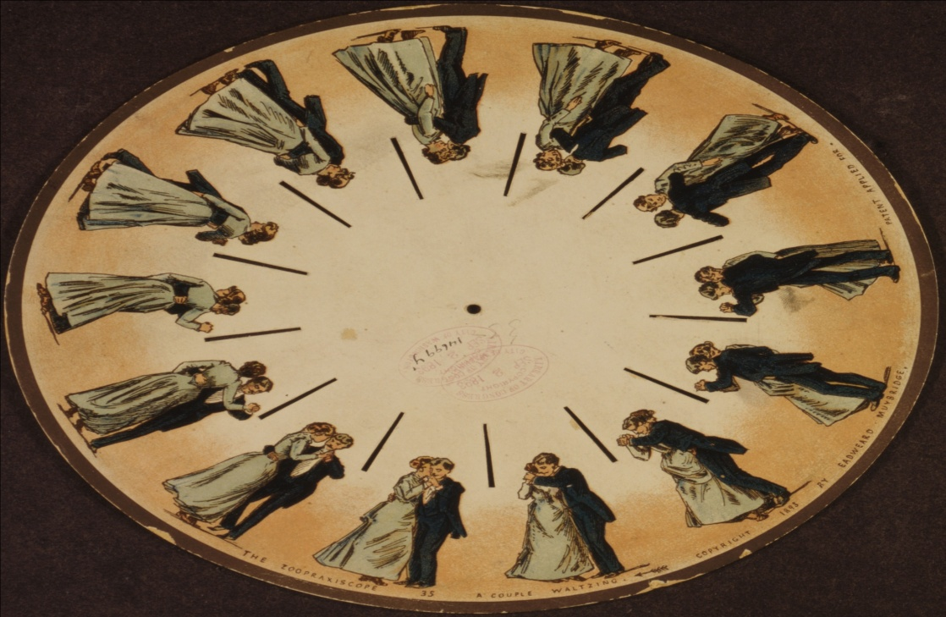
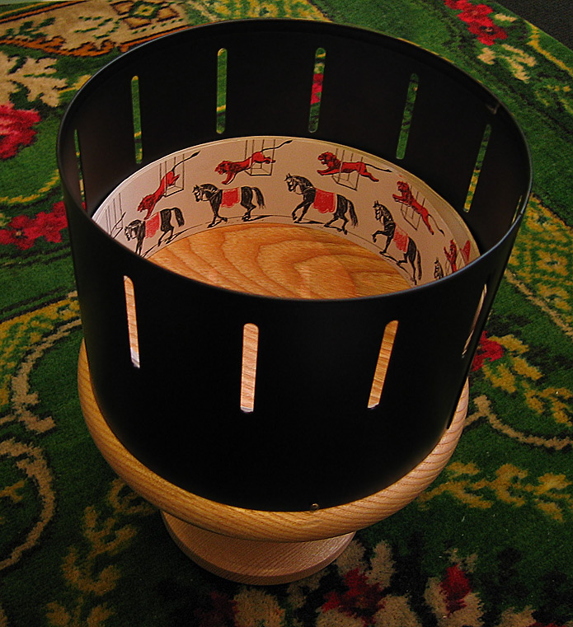
Illusion toys
Phenakistoscope
Zoetrope

Slide 48
Eadweard Muybridge

Slide 49
Eadweard Muybridge
Muybridge was asked, in 1873, by the ex-governor of California - Leland Stanford to settle a bet as to whether horses hooves left the ground when they galloped or not.
In June 1878, Muybridge created sequential series of photographs with a battery of 12 cameras along the race track at Stanford's Palo Alto Stock Farm.
The shutters were automatically triggered when the wheel of a card or the breast or legs of a horse tripped wires connected to an electro-magnetic circuit.
Finally it was proven that a running horse at regular intervals had all four hooves in the air.

Slide 50
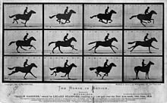
Eadweard Muybridge

Slide 51
History of Film
Thomas A. Edison, with his assistant W.K.L Dickson (who did most of the work), then acquired some Eastman Kodak film stock and began work on a new type of machine.
By 1891, Edison and Dickson have their Kinetograph camera and Kinetoscope viewing box.

Slide 52
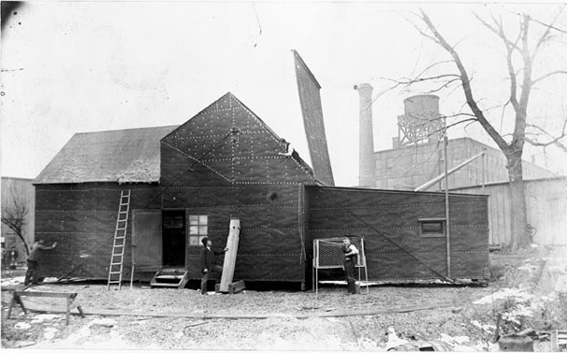
Kinetoscope and Black Maria

Slide 53
Butterfly Dance
Notes:
http://upload.wikimedia.org/wikipedia/commons/7/70/Hapci-fr.gif

Slide 54
First Camera
1892 Using his projecting Praxinoscope, Reynaud holds the first public exhibitions of motion pictures. Reynaud's device was successful, using long strips of hand-painted frames, but the effect was jerky and slow.
h
Notes:
http://en.wikipedia.org/wiki/Charles-%C3%89mile_Reynaud

Slide 55
Cinématographe
1894 The Lumière family is the biggest manufacturer of photographic plates in Europe.
Louis and Auguste design a camera which serves as both a recording device and a projecting device. They call it the Cinématographe.

Slide 56
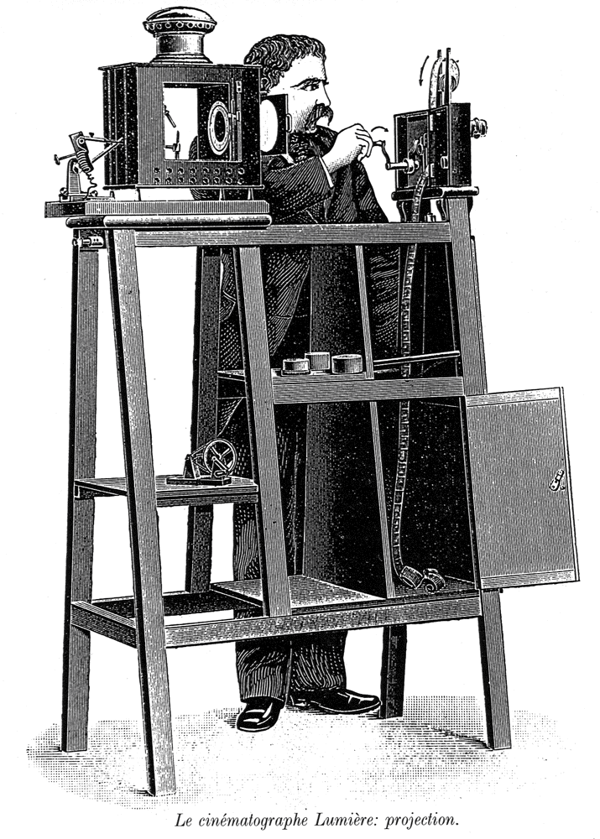
Cinématographe

Slide 57
First Film
1895, La Sortie de l'usine Lumière a Lyon (Workers leaving the Lumière factory at Lyon).

Slide 58
Lumière films
1895 One of the most famous film screenings in history took place on December 28th, 1895.
The venue was the Grand Cafe in Paris and customers paid one Franc for a twenty-five minute programme of ten Lumière films.
These included Feeding the Baby, The Waterer Watered and A View of the Sea.

Slide 59
Silent Films (1895-1905)
Films began developing a narrative structure
Stringing scenes together to tell narratives.
The scenes were later broken up into multiple shots of varying sizes and angles.
Other techniques such as camera movement were realized as effective ways to portray a story on film.
Rather than leave the audience in silence, theater owners would hire a pianist or organist or a full orchestra to play music fitting the mood of the film at any given moment.

Slide 60
Silent Films (1895-1905)
By the early 1920s, most films came with a prepared list of sheet music.
Complete film scores being composed for major productions.

Slide 61
Silent Films (1895-1905)
Acting techniques
Silent film actors emphasized body language and facial expression so that the audience could better understand what an actor was feeling and portraying on screen.
Silent comedies tend to be more popular in the modern era than drama, partly because overacting is more natural in comedy.
The melodramatic acting style was in some cases a habit actors transferred from their former stage experience.

Slide 62
Silent films in Hollywood
The rise of European cinema was interrupted by the outbreak of World War I when the film industry in United States flourished with the rise of Hollywood, typified most prominently by the great innovative work of D.W. Griffith in The Birth of a Nation (1914) and Intolerance (1916) .
However in the 1920s, Russian Filmmaker Sergei Eisenstein, and European filmmakers such as F. W. Murnau, and Fritz Lang, in many ways inspired by the war-time progress of film through Griffith, along with the contributions of Charles Chaplin, Buster Keaton and others, quickly caught up with American film-making and continued to further advance the medium.

Slide 63
First Film with Sound
The first feature-length film with synchronized sound effects and musical soundtrack (canned music and sound effects), but without dialogue, was Warner Bros.' romantic adventure Don Juan (1926). It was premiered in New York in August 1926, and starred John Barrymore

Slide 64
Cinema of India
India is the world's largest producer of films. In 2009, India produced a total of 2961 films on celluloid, that include a staggering figure of 1288 feature films. The provision of 100% foreign direct investment has made the Indian film market attractive for foreign enterprises such as 20th Century Fox, Sony Pictures, and Warner Bros. Prominent Indian enterprises such as Zee, UTV, Adlabs and Sun Network's Sun Pictures also participated in producing and distributing films.

Slide 65
Cinema of India
Following the screening of the Lumière moving pictures in London (1895) cinema became a sensation across Europe and by July 1896 the Lumière films had been in show in Bombay (now Mumbai).
The first short films in India were directed by Hiralal Sen, starting with The Flower of Persia (1898).

Slide 68
Cinema of India
The first full-length motion picture in India was produced by Dadasaheb Phalke, a scholar on India's languages and culture.
He brought together elements from Sanskrit epics to produce his Raja Harishchandra (1913), a silent film in Marathi.
Interestingly, the female roles in the film were played by male actors.
http://www.youtube.com/watch?v=DeTnbEnjh64

Slide 69
Cinema of India
During the early twentieth century cinema as a medium gained popularity across India's population and its many economic sections. Tickets were made affordable to the common man at a low price and for the financially capable additional comforts meant additional admission ticket price. Audiences thronged to cinema halls as this affordable medium of entertainment was available for as low as an anna (4 paisa) in Bombay. The content of Indian commercial cinema was increasingly tailored to appeal to these masses.

Slide 71
Cinema of India
Ardeshir Irani released Alam Ara, the first Indian talking film, on 14 March 1931.
Following the inception of 'talkies' in India some film stars were highly sought after and earned comfortable incomes through acting.
As sound technology advanced the 1930s saw the rise of music in Indian cinema with musicals such as Indra Sabha and Devi Devyani marking the beginning of song-and-dance in India's films.

Slide 72
Cinema of India
Following India's independence, the period from the late 1940s to the 1960s are regarded by film historians as the 'Golden Age' of Indian cinema. Some of the most critically acclaimed Indian films of all time were produced during this period. In commercial Hindi cinema, examples of famous films at the time include the Guru Dutt films Pyaasa (1957) and Kaagaz Ke Phool (1959) and the Raj Kapoor films Awaara(1951) and Shree 420 (1955). These films expressed social themes mainly dealing with working-class urban life in India;

Slide 73
Cinema of India
The period also saw the emergence of a new Parallel Cinema movement, mainly led by Bengali cinema. Early examples of films in this movement include Chetan Anand's Neecha Nagar (1946), Ritwik Ghatak's Nagarik (1952), and Bimal Roy's Two Acres of Land (1953), laying the foundations for Indian neorealism and the "Indian New Wave". Pather Panchali(1955), the first part of The Apu Trilogy (1955–1959) by Satyajit Ray, marked his entry in Indian cinema. The Apu Trilogy won major prizes at all the major international film festivals and led to the 'Parallel Cinema' movement being firmly established in Indian cinema.

Slide 74
Pakistani Cinema
Immediately following the partition, the newly founded Pakistan faced a brain drain where all its highly talented and skilled workers migrated to India, including most actors and directors. Shortage of filming equipment further paralysed the nation's film industry.
With much hardships faced, the new film industry was able to produce its first feature film, Teri Yaad on 7 August, 1948, premièring at the Parbhat Theatre in Lahore.
The following year, Evernew Studios established a studio in the country which would later become the largest film company of the time.
Over the next few years, films that were released reached mediocre success until the release of Do Ansoo on 7 April 1950. Do Ansoo with romantic couple of Sabiha and Santosh became the first film to attain a 25-week viewing making it the first film to reach silver jubilee status.

Slide 75
Pakistani Cinema
Mushtaq Gazdar, the famous film historian, calls the first ten years after independence A Decade of Endurance — symbolising how cinema managed to resurrect itself in Pakistan from the ashes of the Indian subcontinent’s Partition.
The years between 1957 and 1966 are A Decade of Reformation for him — showing how the new country’s film industry consolidated itself.
The next two decades – A Decade of Change and A Decade of Decadence – cover the revolutionary fervour of 1967-76 and the subsequent state-led reaction to it during 1977-1986.
The author has categorised the last of the five decades he has covered as A Decade of Revivalism — in consonance with the revival of democracy in the country during those years.

